Slide 1
Project Presentation of CO-OP Project at Industry (Module-2) (22CS421)
On
Ai Chatbot Using Natural Language Processing
Lakshay, 2210991839
Pratyush Sinha, 2210992082
Shivansh Banyal, 2210992318
Supervised By
Dr. Shikha Tuteja
Department of Computer Science and Engineering,
Chitkara University, Punjab

Slide 2
Introduction
What is this Project?
A Conversational AI Chatbot that understands natural language queries and converts them into structured SQL statements automatically.
Built Using Python , NLP Libraries and a relational database backend.
Non Technical users struggle to retrieve data from databases.This system eliminates that barrier by letting users simply “talk” to the database in natural language.
Users type plain English prompts - the system parses intent , entitles and conditions then generates and executes a correct SQL query .
2

Slide 3

System Architecture and Methodology
User Input
(Natural Language)
NLP Processing
(Tokenize/Parse)
Intent & Entity Extraction
SQL Query Generation
Database Execution
NLP Pipeline
Tokenization splits user text into meaningful tokens.
POS tagging identifies nouns (tables/columns) & verbs (operations).
Named Entity Recognition extracts values and conditions.
Intent Classification
Classifies query intent: SELECT, INSERT, UPDATE, DELETE.
Rule-Based + ML hybrid approach for better accuracy.
Handles ambiguous prompts with fallback clarification.
SQL Generation Engine
Maps parsed entities to database schema dynamically.
Builds parameterized SQL to prevent Injection attacks.
Supports Joins, WHERE, GROUP BY, and ORDER BY clauses.
Execution & Delivery
Connects to MySQL/SQLite via Python Connectors.
Executes queries and returns formatted result sets.
Error handling with user-friendly fallback messages.
3

Slide 4
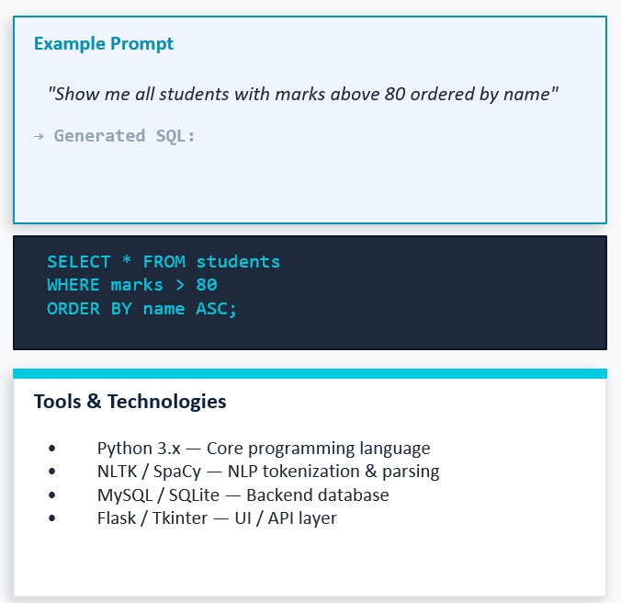
Key Features & Implementation
Core Capabilities
Natural Language input -no sql knowledge
required.
Real-time query generation from typed prompt.
Multi-table Join query support.
Aggregate functions : COUNT, SUM,AVG,MAX.
Handles filters, sorting and grouped results.
Schema-aware mapping for table/column.
Query history and session management.
User friendly error and suggestion messages.
4

Slide 5
5

Slide 6
6

Slide 7
Geographic Disparities & Future Outlook
7

Slide 8
Thank You
8

